Slide 1


LENDING CLUB CASE STUDY

Slide 2
WHAT IS LENDING CLUB?
LENDING CLUB IS THE PEER TO PEER LENDING PLATFORM.
THROUGH LENDING CLUB, INVESTORS WILL JOIN TO INVEST ON LOANS APPLIED BY BORROWER.
BORROWER APPLIES FOR THE LOAN( LOAN_ AMNT) BY PROVIDING THEIR
INCOME( ANNUAL_ INC), CREDIT QUALITY SCORE, PROFESSIONAL EXPERIENCE( EMP_ LENGTH), AND FOR WHAT PURPOSE THEY ARE APPLYING THE LOAN( PURPOSE AND TITLE) AND WHICH PLACE THEY ARE STAYING( ADDR_ STATE) AND ARE THEY STAYING IN THEIR OWN HOUSE /
RENT / MORTGAGE ( HOME_ OWNERSHIP)
LENDING CLUB SHARES THE REQUEST WITH THE INVESTORS.

Slide 3
IF ONCE THEY VALIDATED THE DETAILS, THEY WILL SHARE HOW MUCH AMOUNT GOT
APPROVED BY INVESTORS( FUNDED_ AMNT_ INV) AND THEIR RATE OF INTEREST( INT_ RATE) AND ( GRADE) AND ( SUB_ GRADE) WILL GET DECIDED
BORROWER WILL CHOOSE THE TERM PERIOD ( TERM - 36 MONTHS / 60 MONTHS) TO REPAY THE AMOUNT ALONG WITH THE INTEREST

Slide 4

LET' S UNDERSTAND DATA:
IT CAN BE SEEN THAT THERE ARE 39717 ROWS AND 111 COLUMNS

Slide 5
UNIVARIATE ANALYSIS

Slide 6
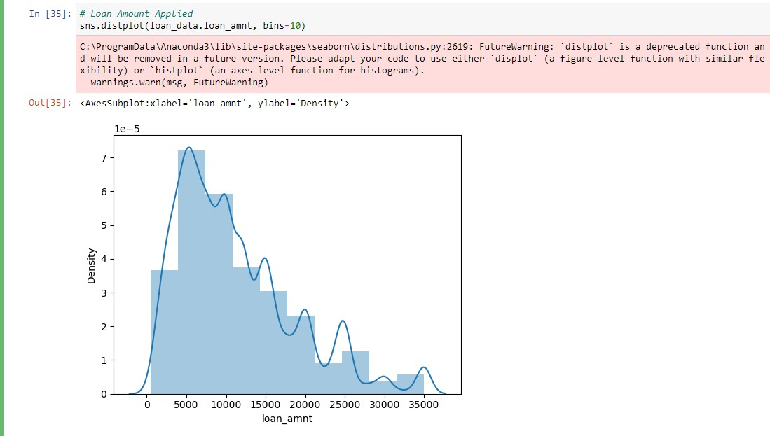
LOAN AMOUNT APPLIED:

Slide 7
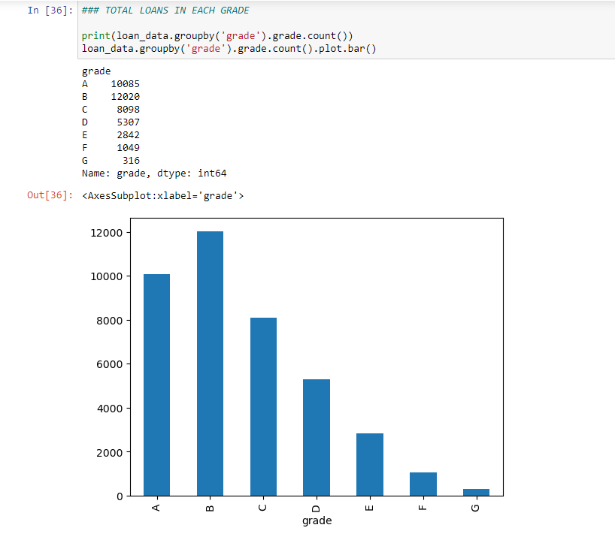
TOTAL LOANS IN EACH GRADE

Slide 8
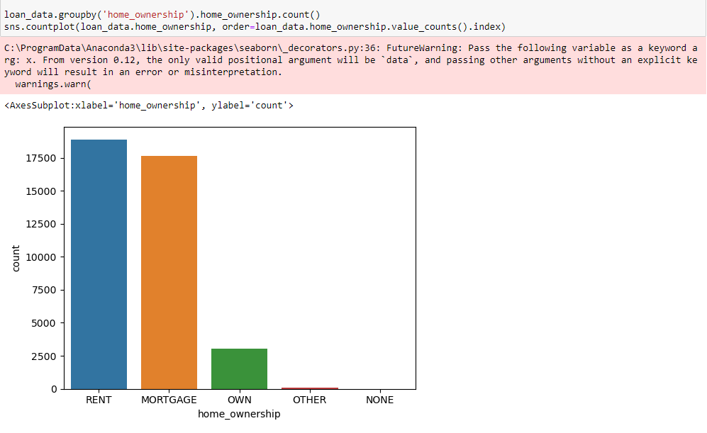
LOAN APPLIED BY HOME OWNERSHIP:

Slide 9
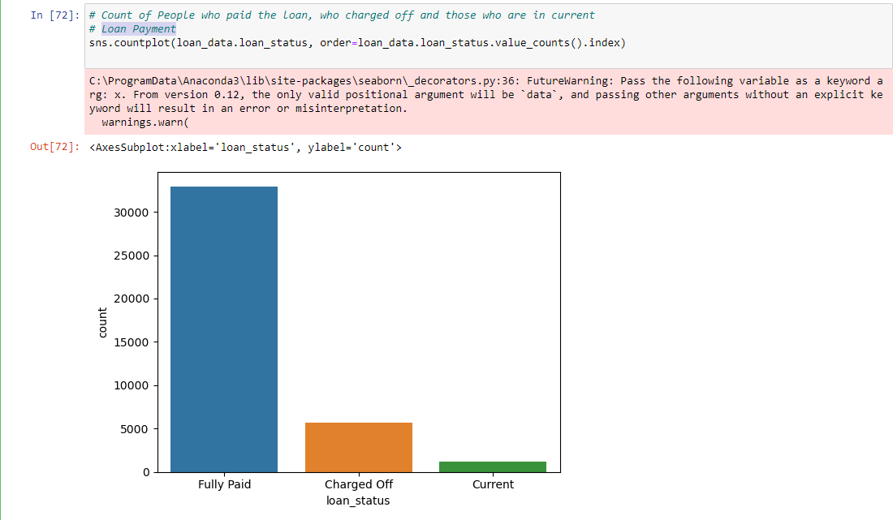
LOAN PAYMENT:

Slide 10
BIVARIATE ANALYSIS

Slide 11
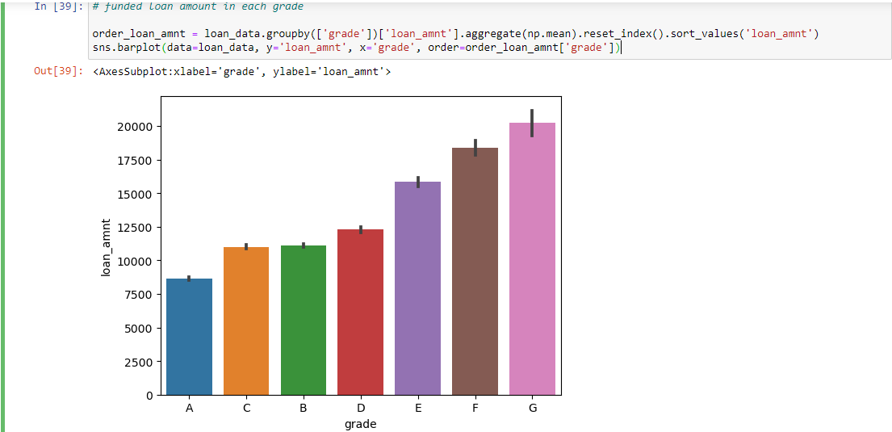
LOAN AMOUNT BY AVERAGE IN EACH GRADE:

Slide 12
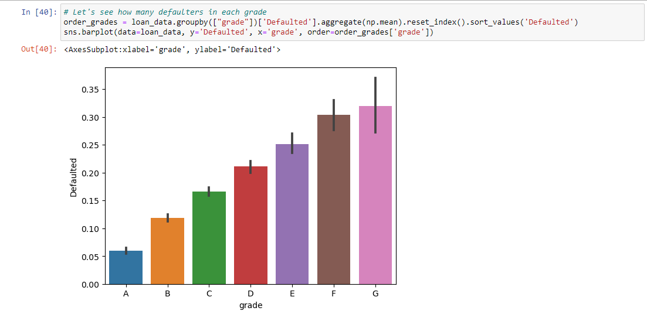
DEFAULTERS BY EACH GRADE

Slide 13
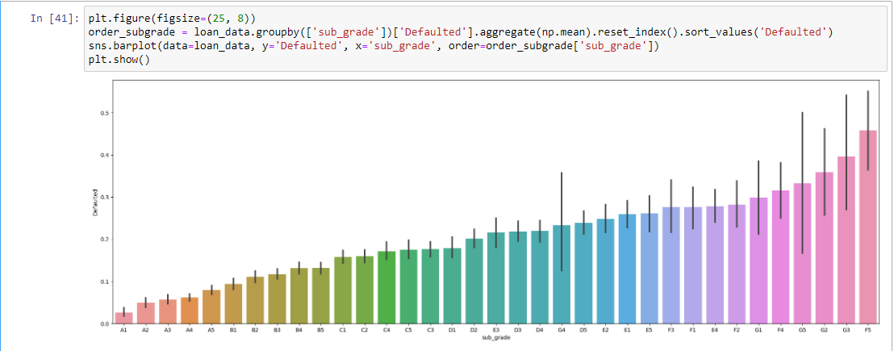
DEFAULTERS BY EACH SUBGRADE:

Slide 14
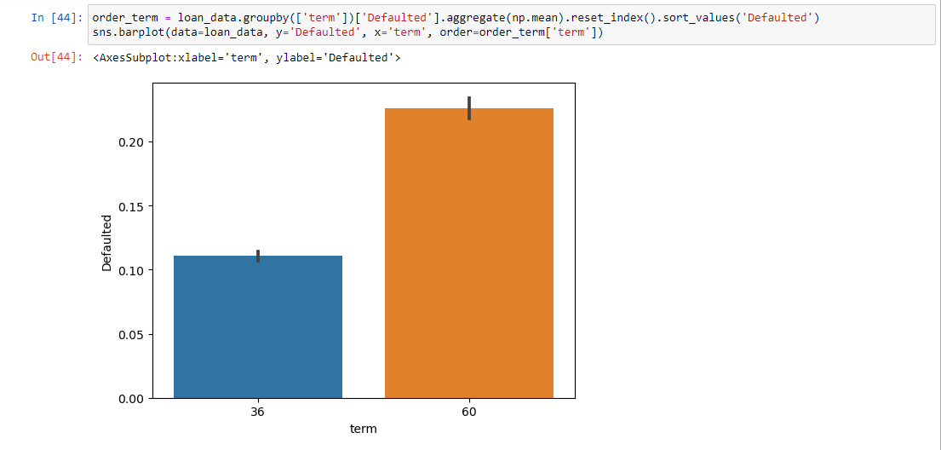
DEFAULTERS WITH RESPECT TO TERM OF LOAN:

Slide 15
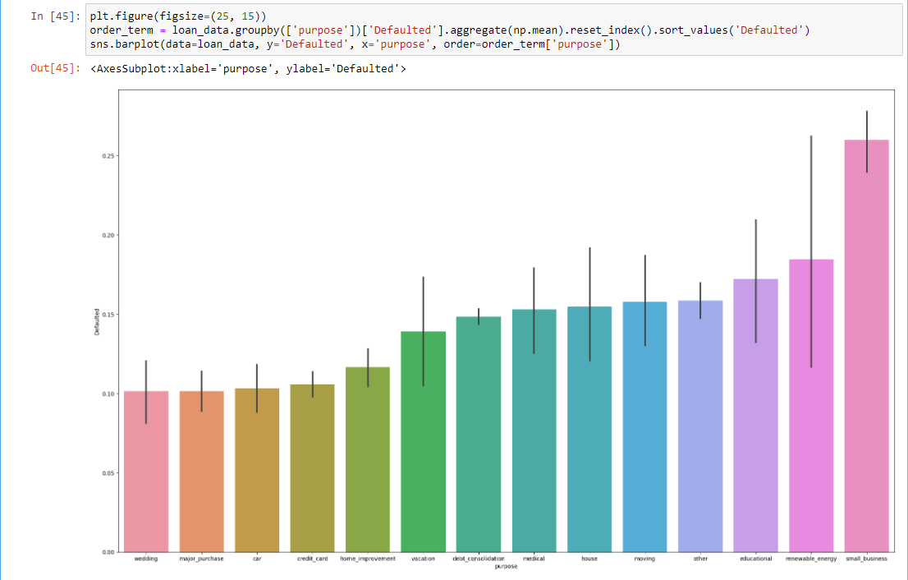
DEFAULTERS W. R. T PURPOSE:

Slide 16
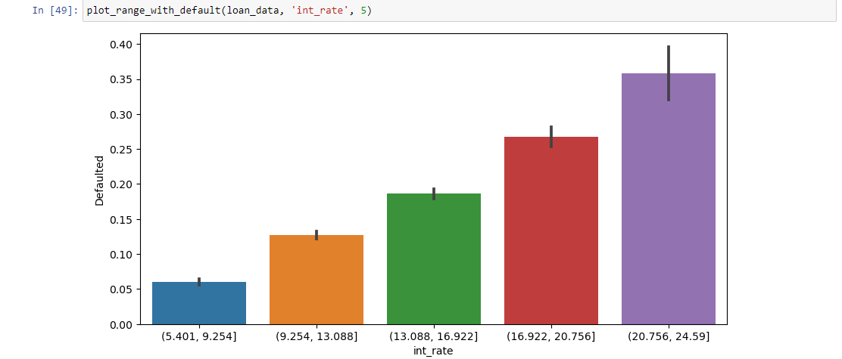
DEFAULTERS W. R. T INTEREST RATE:

Slide 17
DEFAULTERS W. R. T TO TERM AND INTEREST RATE
36 MONTHS & 60 MONTHS

Slide 18
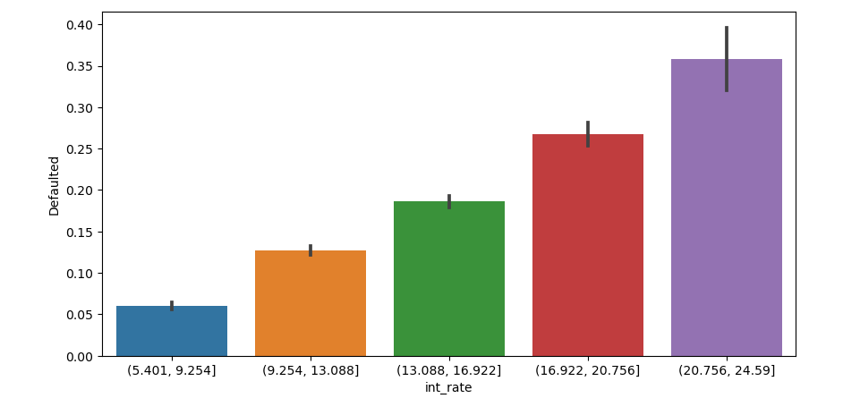

Slide 19
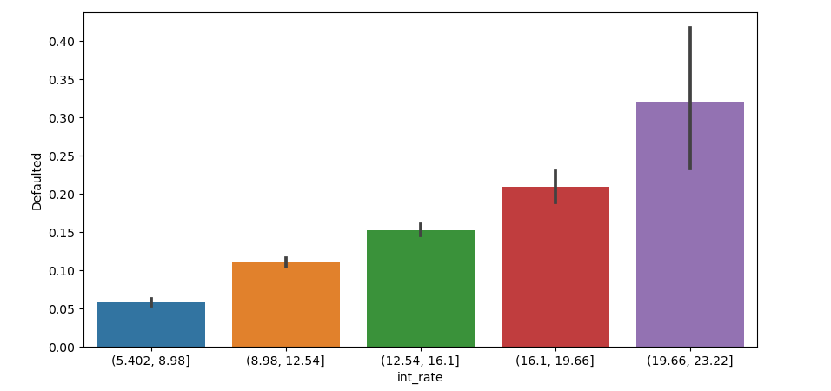

Slide 20
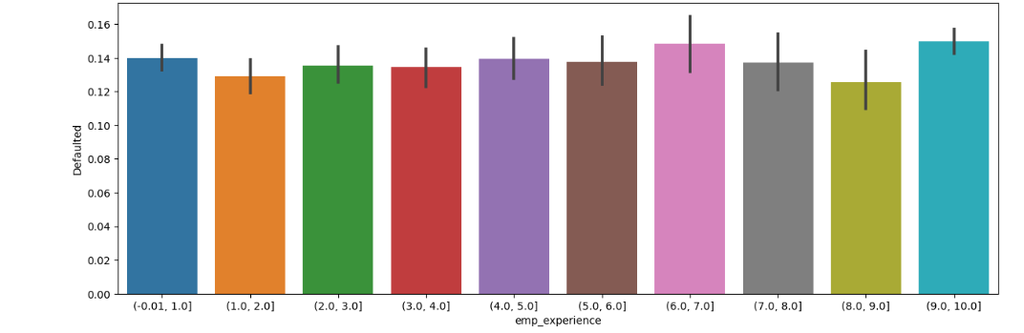
DEFAULTERS W. R. T EMPLOYEE EXPERIENCE:

Slide 21
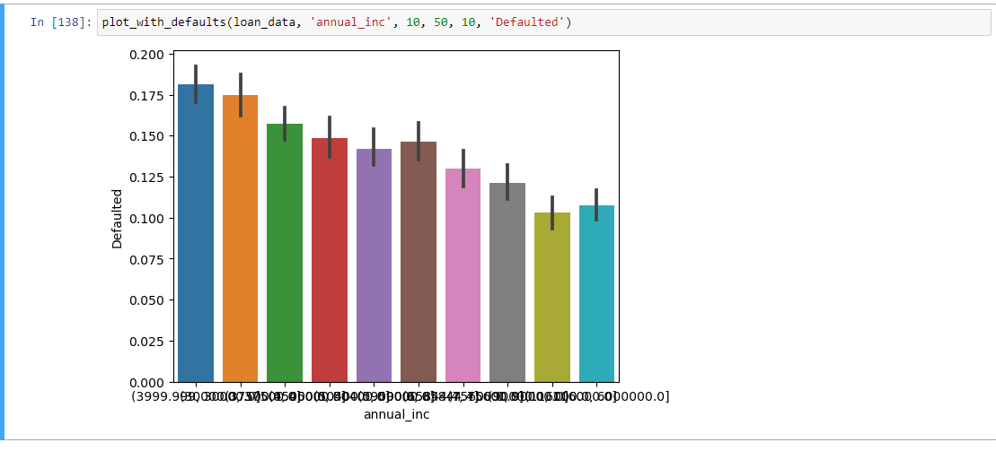
DEFAULTERS W. R. T INCOME:

Slide 22
CONCLUSIONS:
LOAN AMOUNT REQUESTS ARE MAXIMUM IN RANGE OF 0 TO 15 K DOLLARS.
PEOPLE WHO OWN HOME LESS DEFAULTED IN THE LIST.
A PERSON WITH HIGHER SALARY IS LIKELY TO BE LESS DEFAULTER. PEOPLE WHO APPLY FOR SMALL BUSINESS DEFAULT THE MOST.
PEOPLE WITH HIGH INTEREST RATES & LONG TERM ARE LIKELY TO BE DEFAULTED.
A PERSON WHO APPLIES FOR SMALL BUSINESS WITH GRADE E & ABOVE WITH HIGH INTEREST RATE MIGHT DEFAULT

Slide 23
THANKS!

